Slide 1



Creating A virtual enterprise
By Tyler Karpowicz and Yongshi Xu
Notes:
Tyler -

Slide 2
Overview of the Presentation
An introduction of our group project topic
Viewing the inner-workings and architecture behind our project
Analyzing some of the limitations surrounding our project
A showcase of some of the preliminary testing which we conducted
We will be discussing some of our concerns with project, including ethical and legal concerns
We will analyze some of the various implications of the project, as well as a summary of the project
Feel free to ask questions at the end
Notes:
Yongshi -

Slide 3

Introduction of the Group Project
Our project focuses on creating the computing and networking infrastructure for a virtual enterprise.
This project will model how an IT/Systems Administrator would set up these infrastructures for a business.
We will be creating 3 sperate Virtual Machines for the business
1 for each major department in our small-scale model
Users (employees) for each of the departments
Groups for each of the major departments
Subnets for each of the departments
1 subnetwork per department
Access control for each user
Dependent on company rank and department
Notes:
Yongshi - We're creating a model of how the infrastructure of business look like. Give example about Wentworth network

Slide 4
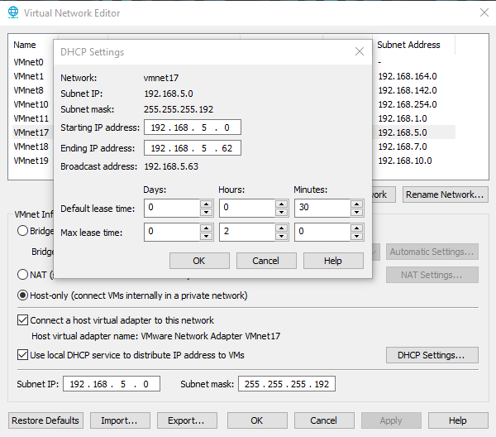
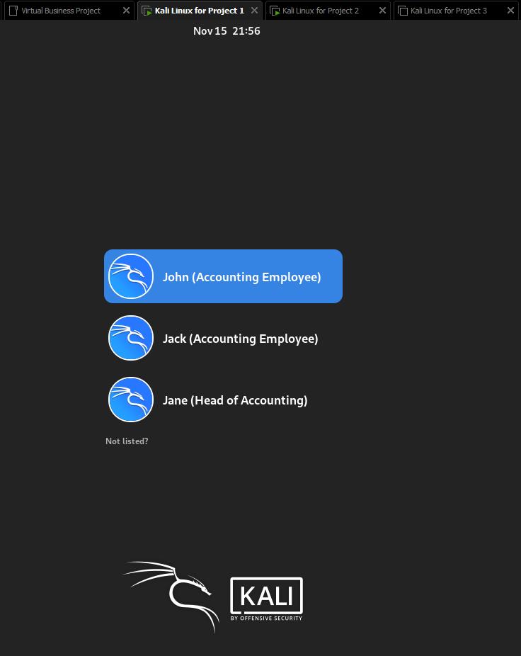
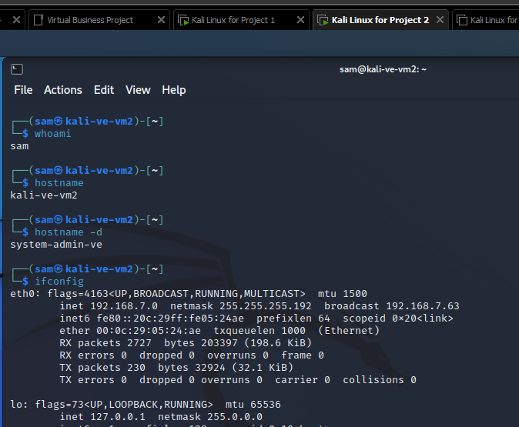
Architecture and Inner-Workings of the project
Corporate Hierarchy
The Accounting Department’s Virtual Network
The Host Machine on the Accounting Department’s Virtual Network
The Inner-Workings of the Sales Department’s Virtual Machine
Management
Head of Sales
Head of Accounting
Sales Employees
Accounting Employees
Notes:
Tyler - We use "sudo adduser <username>" command to create the three accounting for the employee

Slide 5

Limitations of the project
Hardware Limited: Cannot create more than 3 access VMs (without stability issues)
Confined to 32GB of RAM, 1TB of Storage, 10 Cores, 20 Logical Processors
These components need to be split between the 3 VMs
Each VM currently has 4 Cores, 4GB of RAM, and 20GB of Storage
VMWare Limitations
We can only work on the VMs when we meet
Only one of us can configure the VMs outside of our group meetings
Time
Our virtual business implementation needs to match our allotted project time
If we had more time, we could include more users, groups, networks, and files with access control.
Notes:
Tyler -

Slide 6
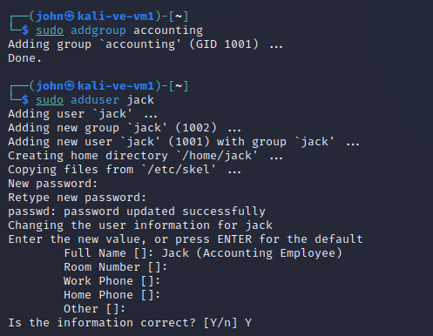
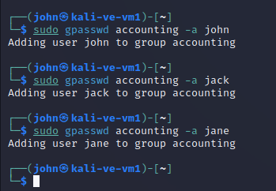
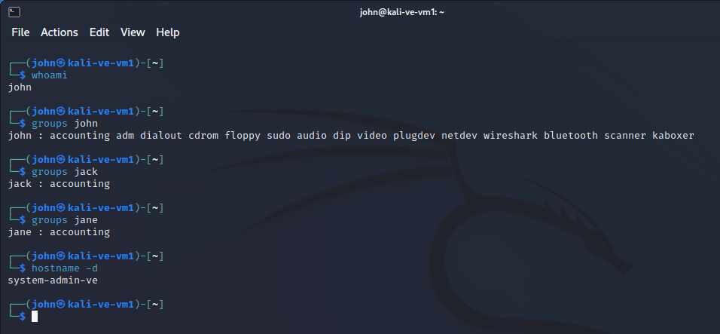
Preliminary Testing Conducted
Creating a new Group and User for the Accounting Department
Adding Users to the Accounting Group
Viewing the Created Users and their Corresponding Group
Notes:
Yongshi -

Slide 7

General, ethical, and legal Concerns of the Project
General Concerns: Inability for VMs to communicate with one another
Given that the VMs are on different subnets, by default, they cannot communicate with each other.
This can be fixed with a Router, such as OPNsense
We would need another VM to act as a router
Ethical Concerns
Using Kali Linux to implement this project could be seen as unethical
Due to Kali Linux being known as a “hacking Linux”
Legal Concerns
Our project’s business model could closely resemble a business in the real world
Could be sued for copying a business’s business model
Notes:
Tyler - Can it be routing if set up host-only networks?

Slide 8

Product implications
The product of this project will allow us to gain much needed System Administration Experience.
Experience with users, groups, and their associated privileges
Experience with network segmentation
Experience with access control of files (shared files/directories)
The knowledge and experience gained from this project will allow us to be well-versed when it comes to our understanding of how to perform tasks commonly used by system administrators.
Notes:
Yongshi - This project will serve as a resource/mode for people studying System Administration, and provide them with ways to practice sys admin implication for a business. Some real world implication, some mistake

Slide 9

Conclusion
Our project aims to resemble the computing and networking infrastructure that a Systems Administrator would implement into a business.
Such as creating separate groups and networks for each department
Creating user accounts and permissions, depending on the employee’s position in the company
Concepts and commands previously learned through the System Administration course will be utilized throughout our project implementation.
Concepts: Creating virtual networks, file and directory access control
Commands: id, groups, usermod, chmod, hostname
This project will provide our group with further insight on the structure, and policies that should be upheld in a business.
How to organize departments, which employees should have access to what data, corporate hierarchy
Notes:
Tyler -

Slide 10
Questions?
Notes:
Tyler -

